Slide 1
How to Use Regret Bounds?
Ashok Cutkosky
Featuring work with:
Kwangjun Ahn, Gagik Magakyan, Harsh Mehta, Francesco Orabona, Hoang Tran, Qinzi Zhang

Slide 2
The plan
Part 1: Some motivation.
Part 2: Online optimization for non-convex optimization.
Part 3: Empirical observations on neural networks (light on math, also light on concrete conclusions).

Slide 3
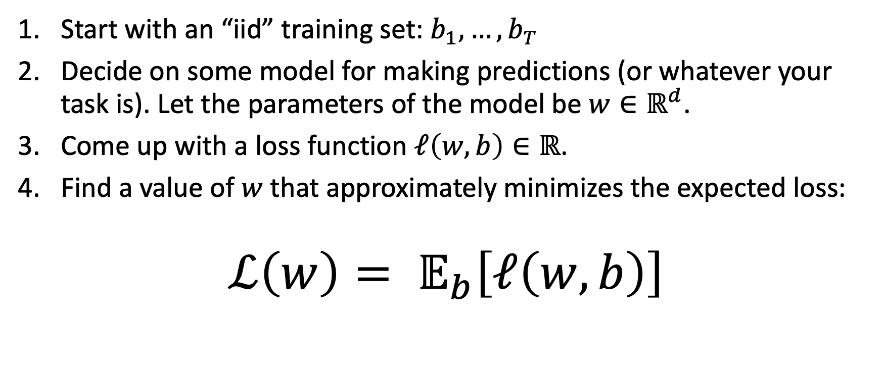
Fixing notation: stochastic optimization
Start with an “iid” training set: $b_{1},…,b_{T}$
Decide on some model for making predictions (or whatever your task is). Let the parameters of the model be $w∈ℝ^{d}$.
Come up with a loss function $ℓ\left(w,b\right)∈ℝ$.
Find a value of $w$that approximately minimizes the expected loss:
$$ℒ\left(w\right)= 𝔼_{b}\left[ℓ\left(w,b\right)\right]$$

Slide 4

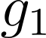

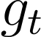
More notation: Online Learning
Technically, we’ll focus on “online linear (or convex) optimization”
Online Learner
Environment
Repeat for many rounds

Slide 5
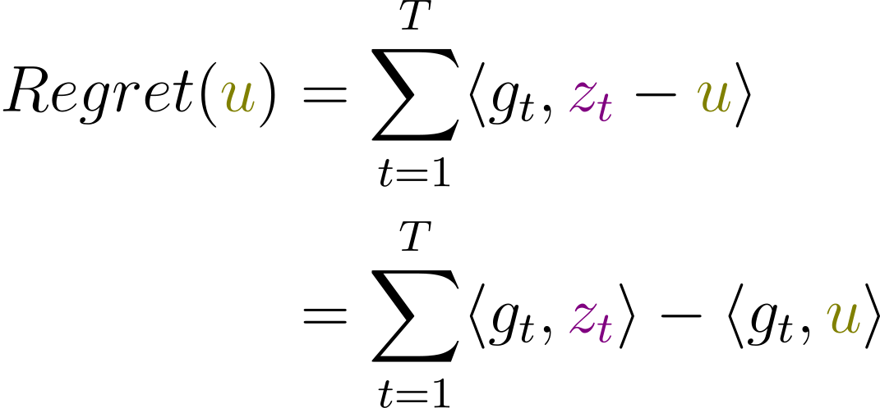

More notation: Online Learning
“loss” of online learner
“loss” of comparison point $u$

Slide 6
Standard ingredients of my online learning papers:
Define online learning.
Describe some particular kind of pattern in the losses that can plausibly lead to smaller regret.
Show an algorithm that indeed obtains the best possible regret in such a case.
Bonus points for an “adaptive” algorithm that also automatically achieves worst-case optimal regret when the pattern is not present.
This is useful because online-to-batch-conversion means that we obtain better stochastic optimization algorithms, and stochastic optimization is key for training neural networks.

Slide 7
The problem: in practice this is terrible
The experiments never use iterate averaging. Because it is terrible.
A good prior for any new theory-based algorithm is: “it does not actually work on neural networks”.
I already have a list of excuses ready for when the experiment fails:
I used an EMA somewhere instead of a global average and the theory wasn’t designed for that.
I was just comparing upper bounds.
It doesn’t apply to non-convex problems anyway.

Slide 8
A way forward?
The fundamental issue: the “optimally tuned in hindsight” algorithm followed by standard online-to-batch methods may not be a not a good algorithm.
We need better reductions from regret to stochastic optimization.
Let me tell you about one conversion for non-convex optimization.

Slide 9
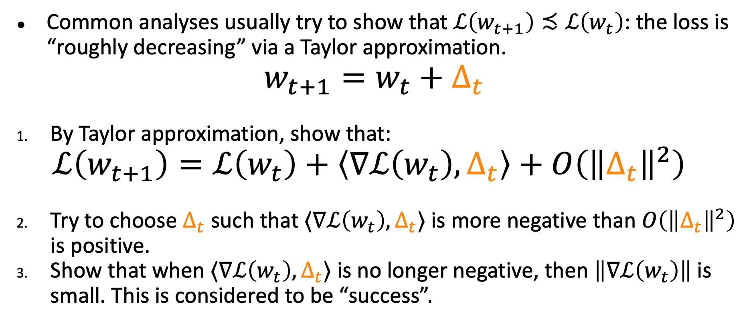
Part 2: Non-convex optimization conversion
Common analyses usually try to show that $ℒ\left(w_{t+1}\right)≾ℒ\left(w_{t}\right)$: the loss is “roughly decreasing” via a Taylor approximation.
$$w_{t+1}=w_{t}+Δ_{t}$$
By Taylor approximation, show that:
$$ℒ\left(w_{t+1}\right)=ℒ\left(w_{t}\right)+\left\langle ∇ℒ\left(w_{t}\right),Δ_{t}\right\rangle +O\left({\left\|Δ_{t}\right\|}^{2}\right)$$
Try to choose $Δ_{t}$ such that $⟨∇ℒ\left(w_{t}\right),Δ_{t}⟩$ is more negative than $O\left({\left\|Δ_{t}\right\|}^{2}\right)$ is positive.
Show that when $⟨∇ℒ\left(w_{t}\right),Δ_{t}⟩$ is no longer negative, then $\left\|∇ℒ\left(w_{t}\right)\right\|$ is small. This is considered to be “success”.

Slide 10
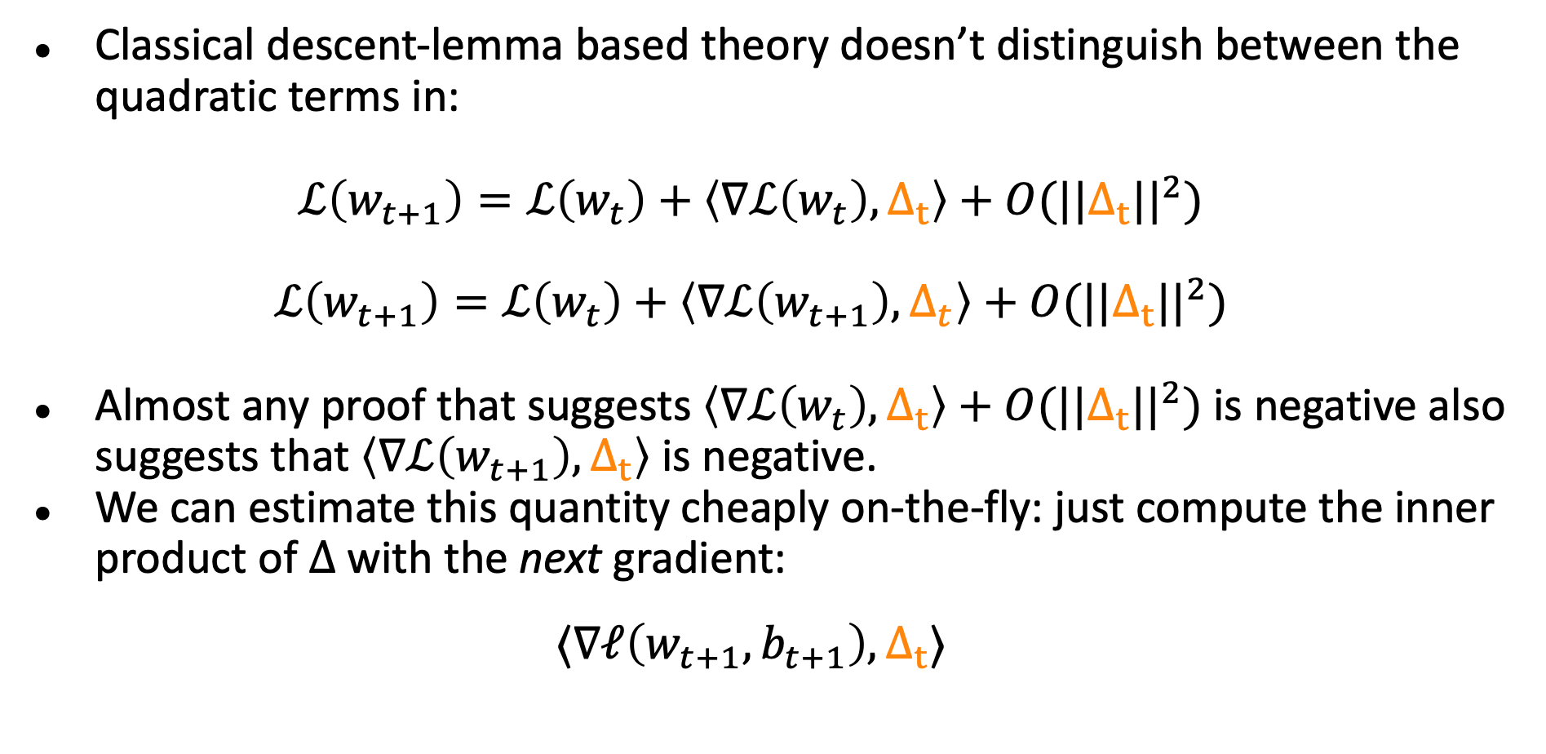
Thinking about descent
Classical descent-lemma based theory doesn’t distinguish between the quadratic terms in:
$$ℒ\left(w_{t+1}\right)=ℒ\left(w_{t}\right)+\left\langle ∇ℒ\left(w_{t}\right),Δ_{t}\right\rangle +O(||Δ_{t}||^{2})$$
$$ℒ\left(w_{t+1}\right)=ℒ\left(w_{t}\right)+\left\langle ∇ℒ\left(w_{t+1}\right),Δ_{t}\right\rangle +O(||Δ_{t}||^{2})$$
Almost any proof that suggests $\left\langle ∇ℒ\left(w_{t}\right),Δ_{t}\right\rangle +O(||Δ_{t}||^{2})$is negative also suggests that $\left\langle ∇ℒ\left(w_{t+1}\right),Δ_{t}\right\rangle$ is negative.
We can estimate this quantity cheaply on-the-fly: just compute the inner product of $Δ$ with the next gradient:
$$⟨∇ℓ\left(w_{t+1},b_{t+1}\right), Δ_{t}⟩$$

Slide 11
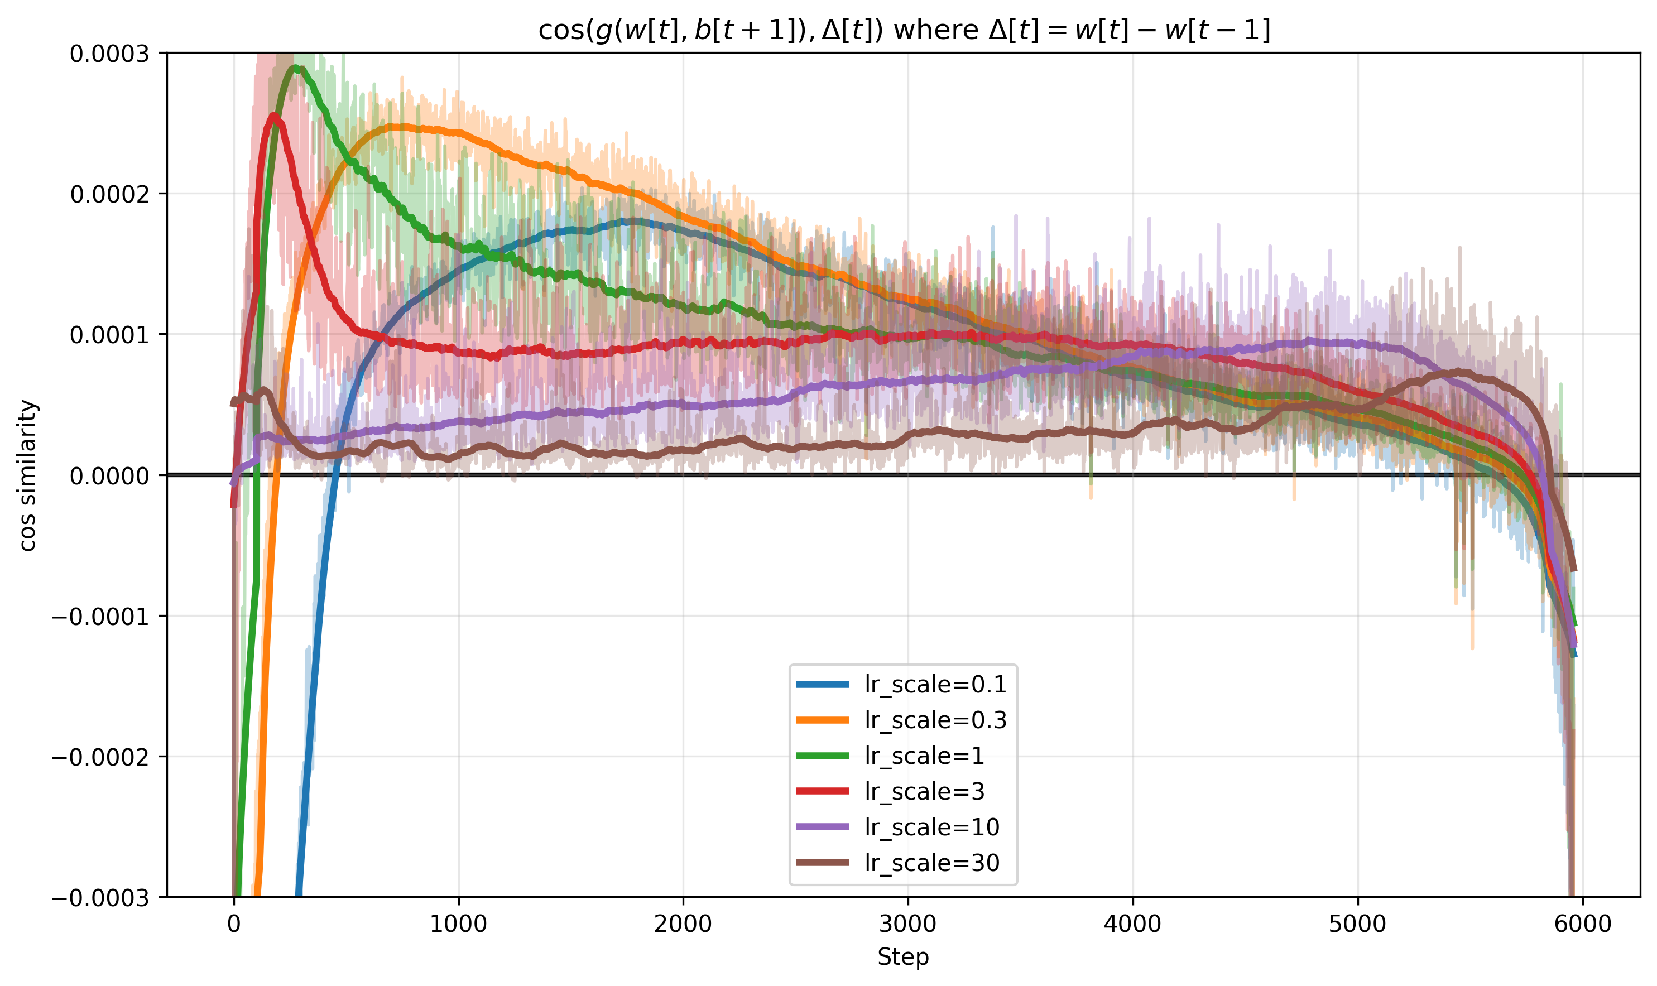
Cos sim of gradient at $w_{t+1}$ with $Δ_{t}$ for different lrs

Slide 12
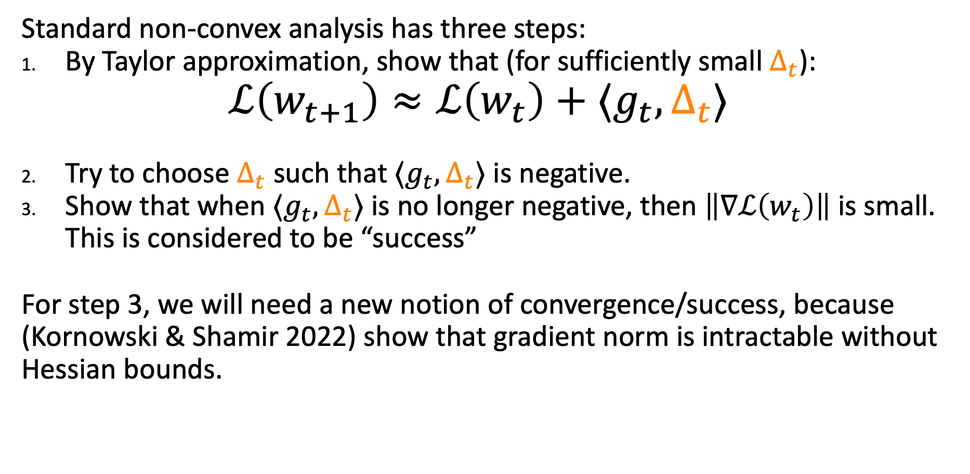
A better way with online learning + one weird trick.
Standard non-convex analysis has three steps:
By Taylor approximation, show that (for sufficiently small $Δ_{t}$):
$$ℒ\left(w_{t+1}\right)≈ℒ\left(w_{t}\right)+⟨g_{t},Δ_{t}⟩$$
Try to choose $Δ_{t}$ such that $⟨g_{t},Δ_{t}⟩$ is negative.
Show that when $⟨g_{t},Δ_{t}⟩$ is no longer negative, then $\left\|∇ℒ\left(w_{t}\right)\right\|$ is small. This is considered to be “success”
For step 3, we will need a new notion of convergence/success, because (Kornowski & Shamir 2022) show that gradient norm is intractable without Hessian bounds.

Slide 13

Goldstein Stationarity: A non-convex convergence criterion that’s plausible without Hessian bounds.
This point is ”morally” approximately stationary
Idea: We should be able to average nearby gradients to reach a small number.
$$w$$

Slide 14
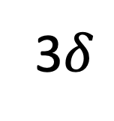
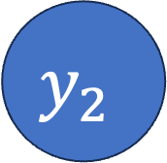
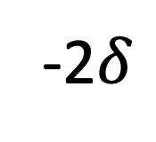
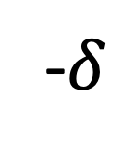
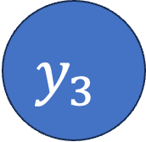
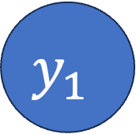
Goldstein Stationarity: A non-convex convergence criterion that’s plausible without Hessian bounds.
This point is ”morally” approximately stationary
$$y_{3}$$
$$y_{1}$$
$$y_{2}$$
$$w$$
-2$δ$
-$δ$
0
3$δ$

Slide 15
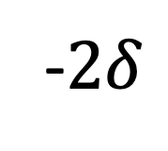
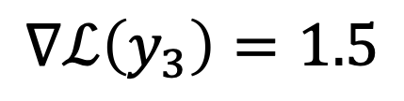
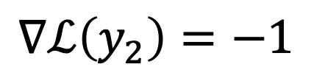
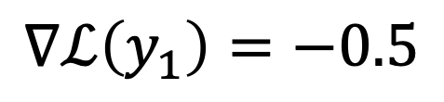
Goldstein Stationarity: A non-convex convergence criterion that’s plausible without Hessian bounds.
This point is ”morally” approximately stationary
$$y_{3}$$
$$∇ℒ\left(y_{1}\right)=−0.5$$
$$y_{1}$$
$$y_{2}$$
$$∇ℒ\left(y_{3}\right)=1.5$$
$$w$$
$$∇ℒ\left(y_{2}\right)=−1$$
-$2δ$
-$δ$
0
3$δ$

Slide 16
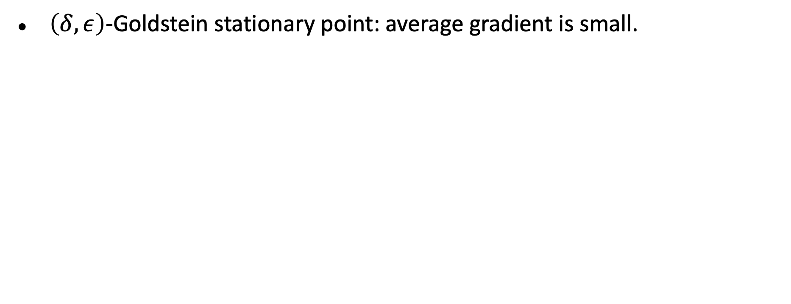
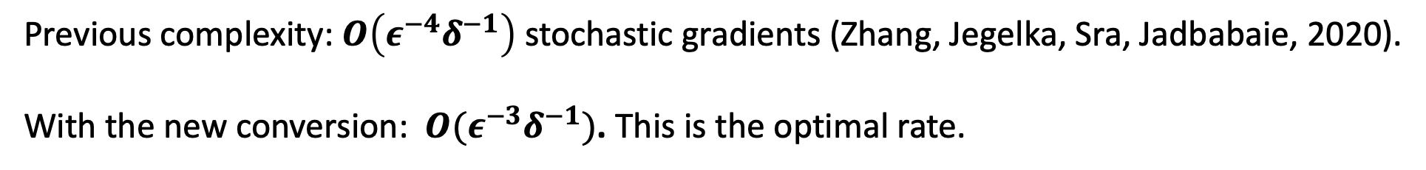
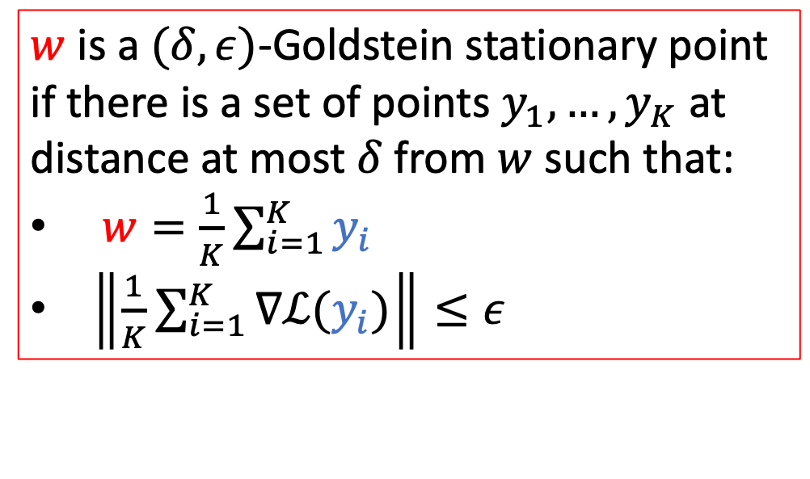
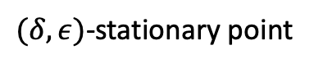
convergence criterion for non-smooth optimization
$\left(δ,ε\right)$-Goldstein stationary point: average gradient is small.
$w$ is a $(δ,ε)$-Goldstein stationary point if there is a set of points $y_{1},…,y_{K}$ at distance at most $δ$ from $w$ such that:
$w=\frac{1}{K}\sum_{i=1}^{K}{y_{i}}$
$\left\|\frac{1}{K}\sum_{i=1}^{K}{∇ℒ(y_{i})}\right\|≤ε$
$(δ,ε)$-stationary point
Previous complexity: $O\left(ε^{−4}δ^{−1}\right)$ stochastic gradients (Zhang, Jegelka, Sra, Jadbabaie, 2020).
With the new conversion: $O(ε^{−3}δ^{−1})$. This is the optimal rate.

Slide 17
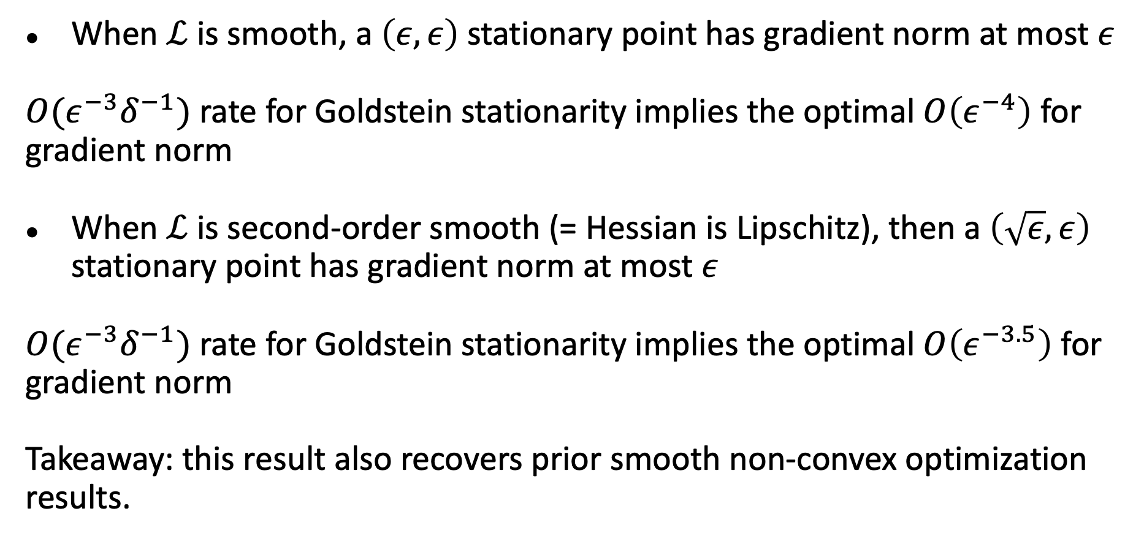
Relationship to smooth optimization
When $ℒ$ is smooth, a $\left(ε,ε\right)$ stationary point has gradient norm at most $ε$
$O(ε^{−3}δ^{−1})$ rate for Goldstein stationarity implies the optimal $O\left(ε^{−4}\right)$ for gradient norm
When $ℒ$ is second-order smooth (= Hessian is Lipschitz), then a $\left(\sqrt{ε},ε\right)$ stationary point has gradient norm at most $ε$
$O(ε^{−3}δ^{−1})$ rate for Goldstein stationarity implies the optimal $O\left(ε^{−3.5}\right)$ for gradient norm
Takeaway: this result also recovers prior smooth non-convex optimization results.

Slide 18
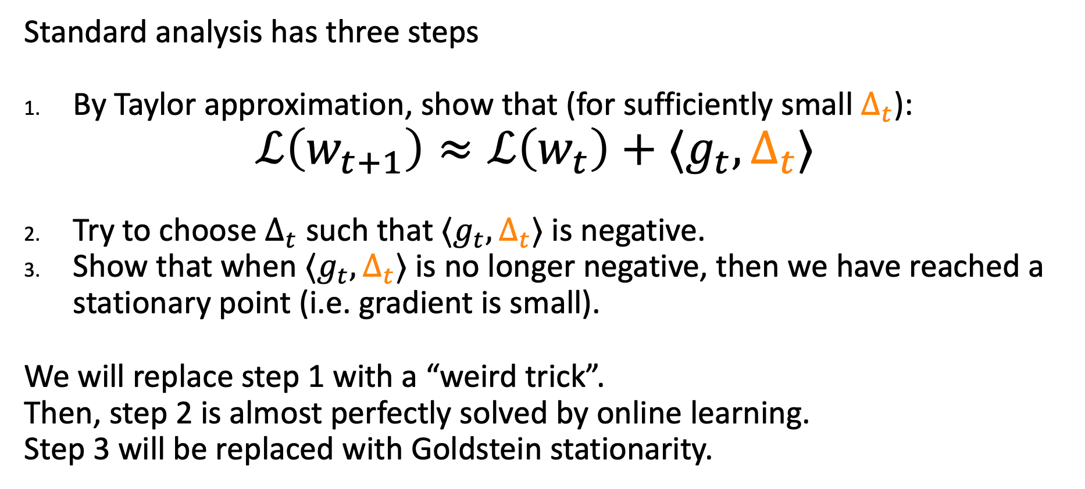
A better way with online learning + one weird trick.
Standard analysis has three steps
By Taylor approximation, show that (for sufficiently small $Δ_{t}$):
$$ℒ\left(w_{t+1}\right)≈ℒ\left(w_{t}\right)+⟨g_{t},Δ_{t}⟩$$
Try to choose $Δ_{t}$ such that $⟨g_{t},Δ_{t}⟩$ is negative.
Show that when $⟨g_{t},Δ_{t}⟩$ is no longer negative, then we have reached a stationary point (i.e. gradient is small).
We will replace step 1 with a “weird trick”.
Then, step 2 is almost perfectly solved by online learning.
Step 3 will be replaced with Goldstein stationarity.

Slide 19
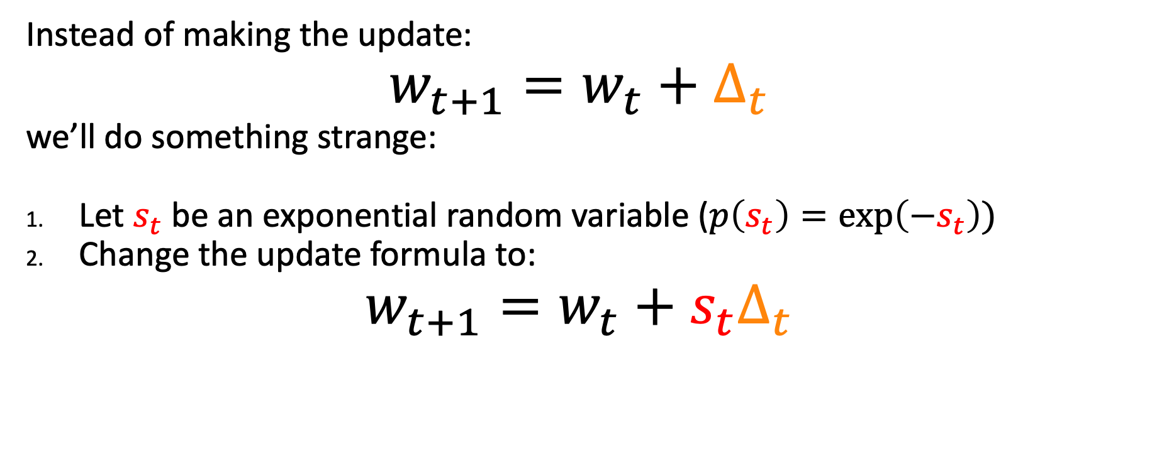
The weird trick
Instead of making the update:
$$w_{t+1}=w_{t}+Δ_{t}$$
we’ll do something strange:
Let $s_{t}$ be an exponential random variable ($p\left(s_{t}\right)=\exp\left(−s_{t}\right))$
Change the update formula to:
$$w_{t+1}=w_{t}+s_{t}Δ_{t}$$

Slide 20
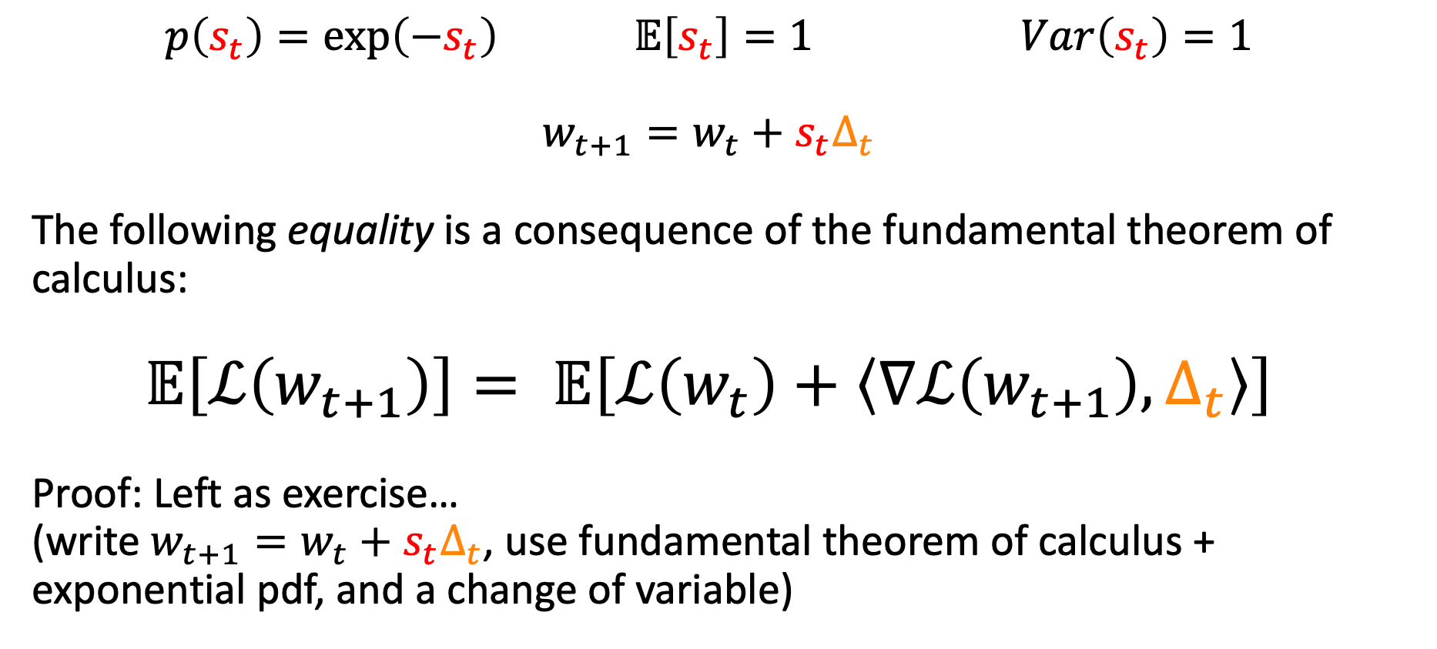
The weird trick
$$p\left(s_{t}\right)=\exp\left(−s_{t}\right) 𝔼\left[s_{t}\right]=1 Var\left(s_{t}\right)=1$$
$$w_{t+1}=w_{t}+{s_{t}Δ}_{t}$$
The following equality is a consequence of the fundamental theorem of calculus:
$$𝔼\left[ℒ\left(w_{t+1}\right)\right]= 𝔼\left[ℒ\left(w_{t}\right)+\left\langle ∇ℒ\left(w_{t+1}\right),Δ_{t}\right\rangle \right]$$
Proof: Left as exercise…
(write $w_{t+1}=w_{t}+s_{t}Δ_{t}$, use fundamental theorem of calculus + exponential pdf, and a change of variable)

Slide 21
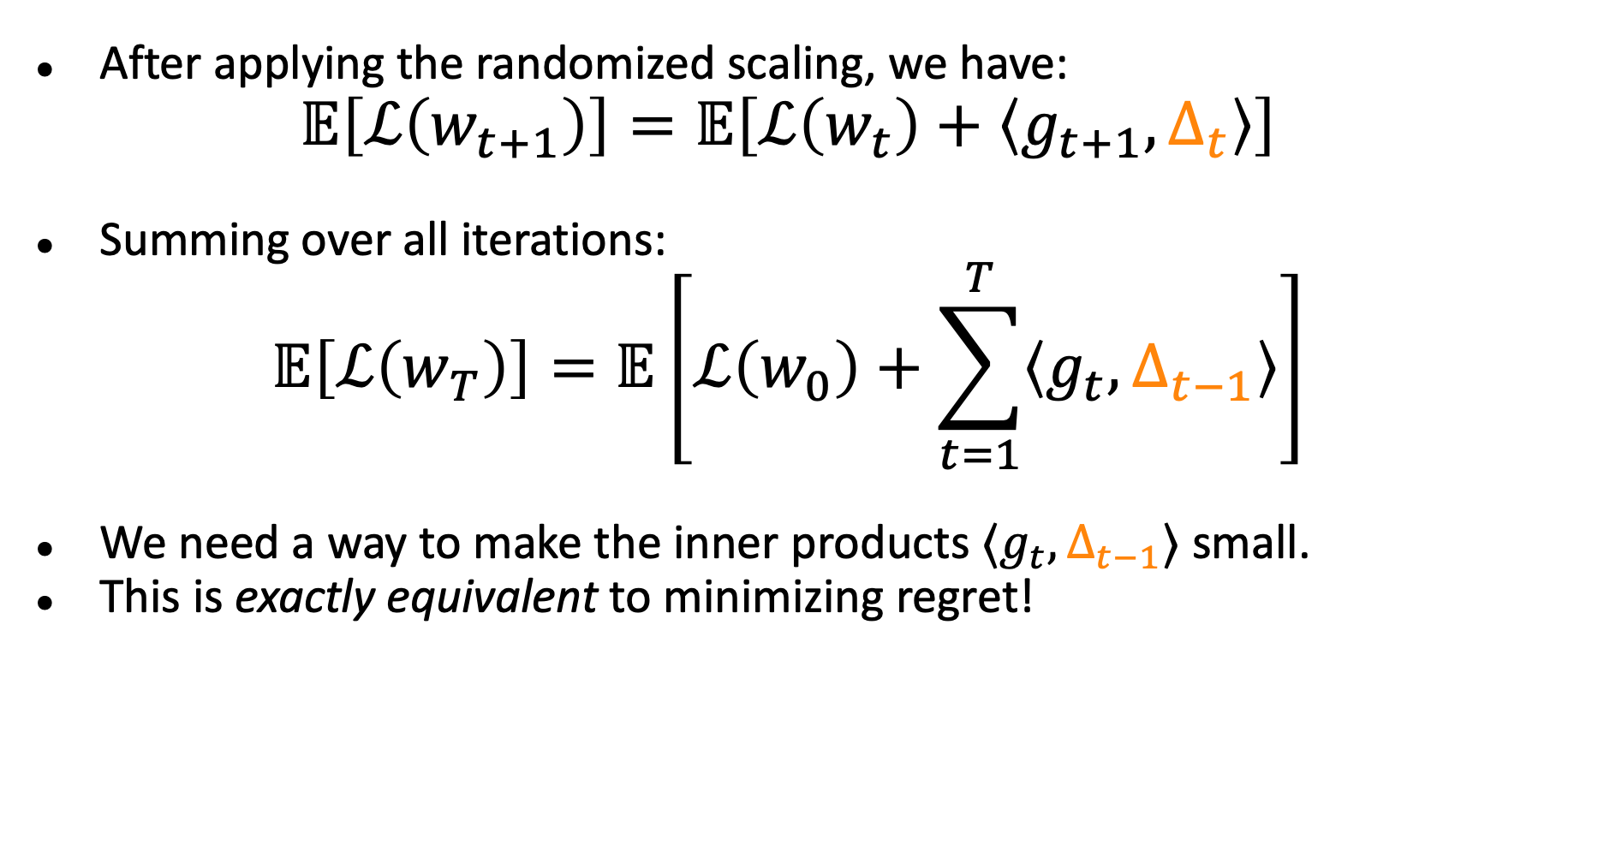
The role of online learning
After applying the randomized scaling, we have:
$$𝔼\left[ℒ\left(w_{t+1}\right)\right]=𝔼\left[ℒ\left(w_{t}\right)+\left\langle g_{t+1},Δ_{t}\right\rangle \right]$$
Summing over all iterations:
$$𝔼\left[ℒ\left(w_{T}\right)\right]=𝔼\left[ℒ\left(w_{0}\right)+\sum_{t=1}^{T}{\left\langle g_{t},Δ_{t−1}\right\rangle }\right]$$
We need a way to make the inner products $⟨g_{t},Δ_{t−1}⟩$ small.
This is exactly equivalent to minimizing regret!

Slide 22
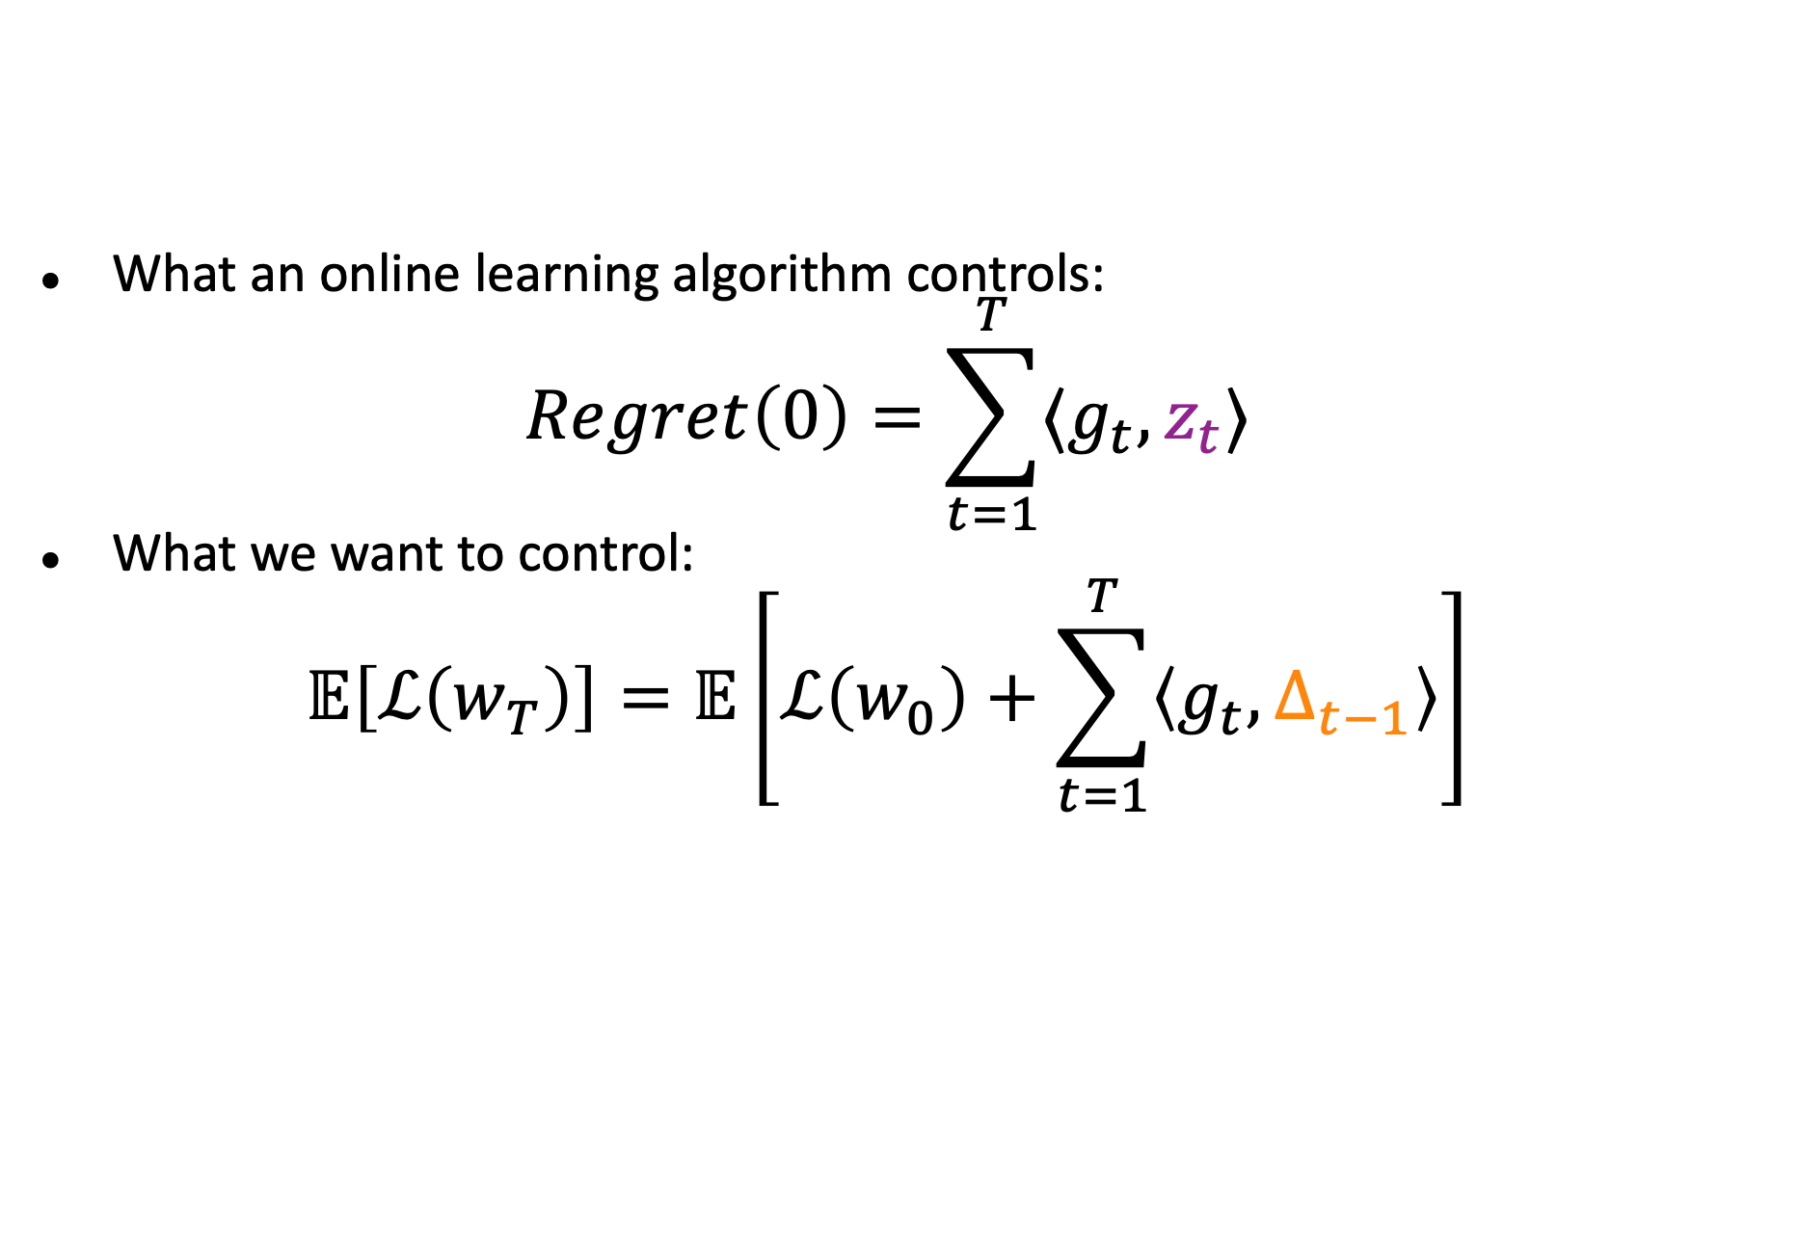
Low regret = small inner product
What an online learning algorithm controls:
$$Regret\left(0\right)=\sum_{t=1}^{T}{⟨g_{t}, z_{t}⟩}$$
What we want to control:
$$𝔼\left[ℒ\left(w_{T}\right)\right]=𝔼\left[ℒ\left(w_{0}\right)+\sum_{t=1}^{T}{\left\langle g_{t},Δ_{t−1}\right\rangle }\right]$$

Slide 23



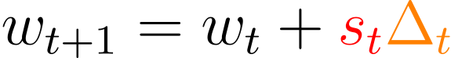
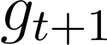
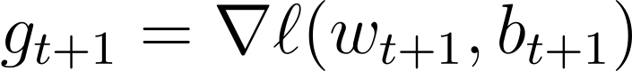
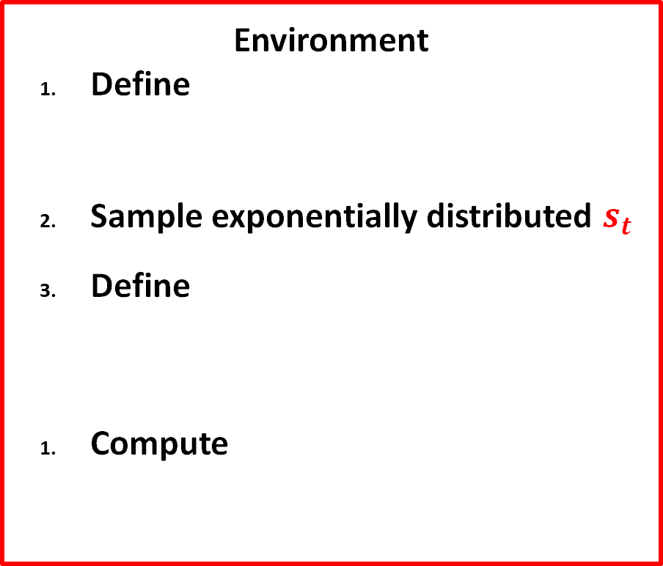
Online to Non-convex Conversion [CMO23] [ZC24]
Online Learner
Environment
Define
Sample exponentially distributed $s_{t}$
Define
Compute

Slide 24
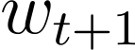
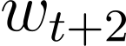
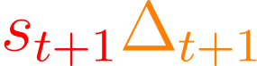

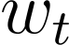
Using Online Learning to choose Updates

Slide 25


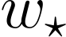
Using Online Learning to choose Updates

Slide 26
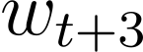
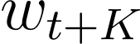


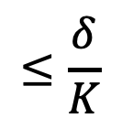
Using Online Learning to choose Updates
Ensure $\left\|Δ_{t}\right\|≤\frac{δ}{K}$ via constraint of online learner
$$w$$
$$≤\frac{δ}{K}$$
Average iterate

Slide 27

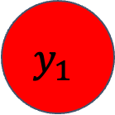
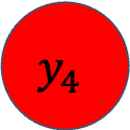
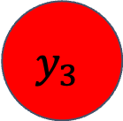
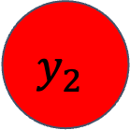
Using Online Learning to choose Updates
$$y_{2}$$
$$y_{3}$$
$$y_{4}$$
$$w$$
$$y_{1}$$
$$y_{K}$$
Average iterate

Slide 28
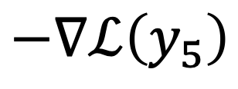
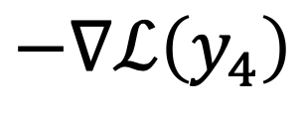
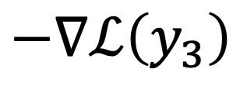
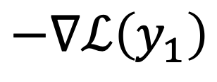
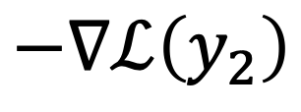
Using Online Learning to choose Updates
$$−∇ℒ\left(y_{2}\right)$$
$$−∇ℒ\left(y_{3}\right)$$
$$y_{2}$$
$$y_{3}$$
$$−∇ℒ\left(y_{4}\right)$$
$$y_{4}$$
$$−∇ℒ\left(y_{1}\right)$$
$$w$$
$$y_{1}$$
$$y_{K}$$
$$−∇ℒ\left(y_{5}\right)$$
Average iterate

Slide 29
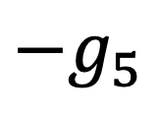





Using Online Learning to choose Updates
If $\left\|\frac{1}{K}\sum_{i=1}^{K}{g_{i}}\right\|≤ε$, then $w$ is a $\left(δ,ε\right)$ stationary point
$$−g_{2}$$
$$−g_{3}$$
$$y_{2}$$
$$y_{3}$$
$$−g_{4}$$
$$y_{4}$$
$$−g_{1}$$
$$w$$
$$y_{1}$$
$$y_{K}$$
$$−g_{5}$$
Average iterate

Slide 30

Online to Non-convex Conversion
Define:
Then we have for all K:
Choose D and K carefully, repeat T/K times and telescope.
Either this is very big, or you have found a Goldstein stationary point…

Slide 31
Now for some experiments
Optimization theory rarely influences practice.
Maybe we can do some experiments to ask which parts of our analysis are useful and which parts are not.

Slide 32
gradient at $w_{t+1}$ vs $Δ_{t}$

Slide 33

cos of gradient at $w_{t+1}$ with $Δ_{t}$on the SAME batch.

Slide 34

cos of gradient at $w_{t+1}$ with $w_{t}$ on SAME batch.

Slide 35
Some thoughts…
Classical descent-lemma based arguments seem to be missing something important.
Similar to the “edge of stability” notion (Cohen, Kaur, Li, Kolter, Talwakar 2021)
The non-convex approach described here technically avoids this issue:
the update-gradient correlation MUST be negative, otherwise the loss would actually be going up (because there is no Taylor error to absorb any positive-ness)
I’m not sure it avoids it “in spirit” because it is still fundamentally a “descent-like” argument.

Slide 36

Convexity ratio
Convex-inspired algorithms work surprisingly well… maybe neural networks are “kind of” convex?
Convexity ratio:
$$\frac{\left\langle ∇ℓ\left(w_{t}, b_{t}\right),w_{t}−w_{T}\right\rangle }{ℓ\left(w_{t}, b_{t}\right)−ℓ\left(w_{T}, b_{t}\right)}$$
Essentially, assume that $w_{T}$ is “close to optimum”.
As long as this is positive, then regret-based analysis is useful.

Slide 37

Convexity Ratio

Slide 38
Maybe the loss contours looks like a banana?
A common “hard” loss in optimizer benchmarks.
Would plausibly also produce the same kinds of convexity ratio if the bend is not too acute.
Even if we don’t see non-convexity along optimization line
We might see non-convexity along this “linear interpolation” line.

Slide 39

Convexity Ratio along the line between $w_{0}$ and $w_{T}$

Slide 40


Convexity Ratio with $w_{T}$ coming from a different learning rate (but same initialization)

Slide 41

Convexity ratio with different initialization

Slide 42

Conclusions
It seems that there is a little bit of convex-like behavior in real optimization paths.
Lots of caveats:
${w_{t}−w}_{T}$ is in some sense “by definition” anti-correlated with the gradient, at least for $t$ close to $T$.
Making significant changes to the optimization path seems to mess things up.
On the other hand, it seems unlikely that the optimization landscape has a difficult highly curved “banana like” contours.

Slide 43
Summary
We have really good online optimization algorithms: I think we need better ways to convert them to stochastic optimization.
Most smoothness-based analysis for non-convex optimization is missing some important ingredient in order to explain real neural network optimization algorithms.
Surprisingly, convexity/regret based calculations seem arguably more descriptive for neural networks, but still miss much of the picture.

